Slide 1
Anna Sewell and Black Beauty
Key information about Anna Sewell and her novel, Black Beauty

Slide 2
Anna Sewell

Slide 3
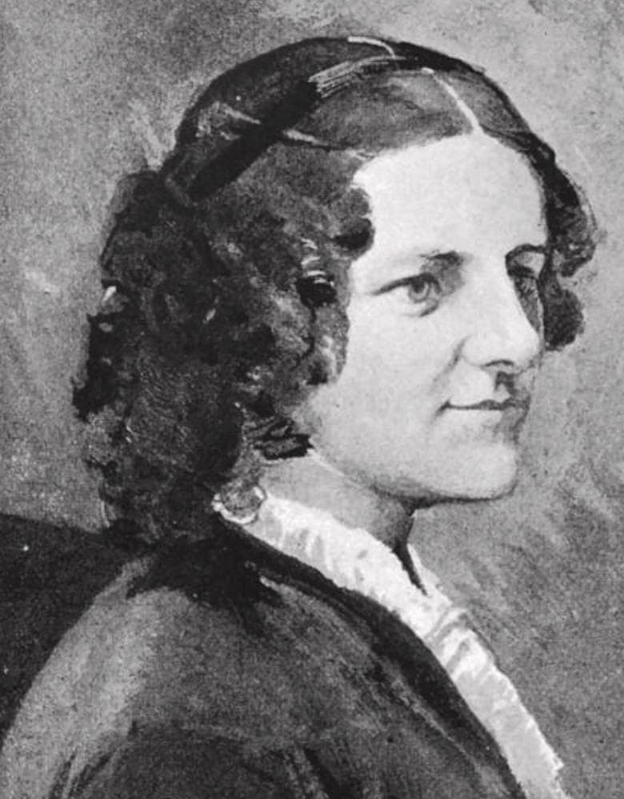
Born in Great Yarmouth in 1820
Moved around a lot as a child
Visited family in Buxton, where she learned to ride horses
Anna suffered an accident as a teenager that meant she couldn’t walk long distances for the rest of her life. She relied on horses to get her around.
This taught her the “secrets of horses” – she felt close to them, and was saddened by the way others mistreated them.
In her adult life, her health deteriorated until she was confined to her house.
Though she could no longer go out and see horses, she dreamt up a companion: Black Beauty. She wrote a book about the life of a horse, which was published shortly before she died, in 1878.

Slide 4
Black Beauty

Slide 5
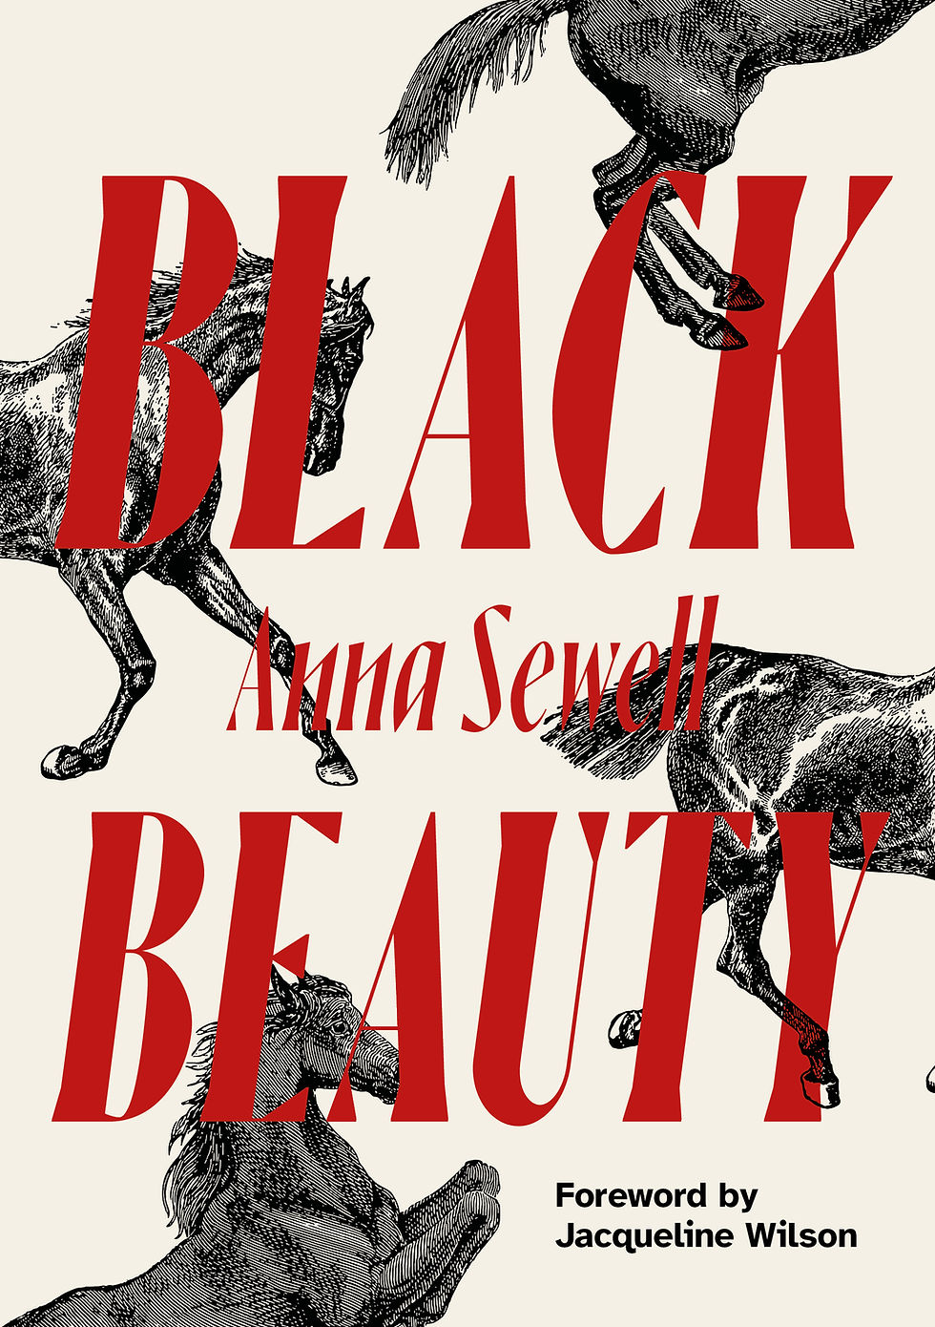
The book tells the story of a horse named Black Beauty, who is born on a farm, and sold to various owners to do various jobs. It was written to draw attention to the often poor conditions horses were subjected to.
Anna Sewell hoped it would “induce kindness, sympathy, and an understanding treatment of horses.”
It was not just about a horse: it was written in the voice of the horse. This meant that readers felt emotionally connected to an animal and his story.
Anna Sewell’s hopes for horses are a lot like Redwings’ mission: Redwings exists to improve the lives and welfare of horses. The new edition of Black Beauty, produced in collaboration with Redwings, will raise money for horses and continue Anna Sewell’s legacy of kindness and understanding towards horses.

Slide 6
Horses in everyday life

Slide 7
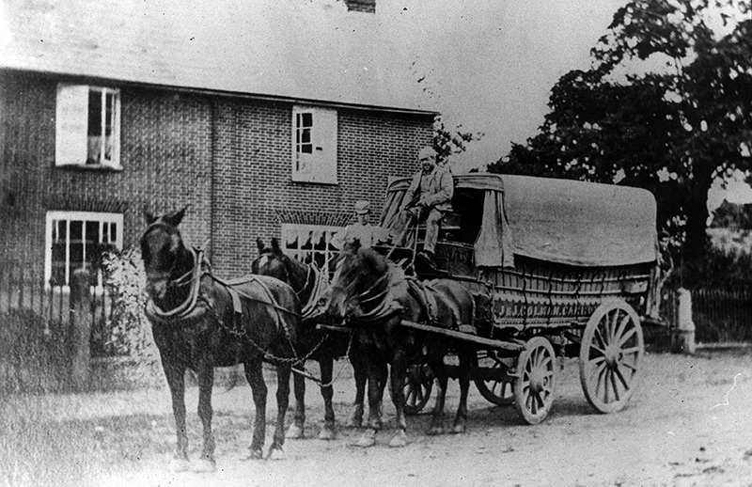
Though it’s hard to imagine now, horses were everywhere in the nineteenth century.
They were used in farming, factories, mines, and transported people and goods around towns, cities, and villages.
There was 1 horse to every 10 humans (activity: how many horses would there be here?)
Humanity’s relationship with horses goes back thousands of years: there are horses in cave paintings from fifteen thousand years ago! And in Norfolk, horses have been found on Iceni coins, which are nearly two thousand years old.

Slide 8
Getting to know horses

Slide 9
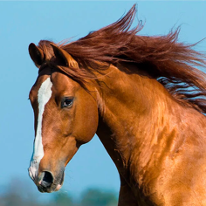
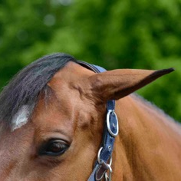
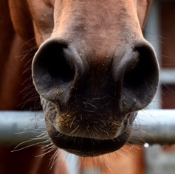
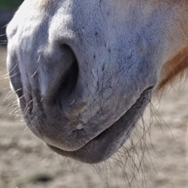
Horses might not be able to talk to us in real life, but they do communicate how they’re feeling through their body language.
Here are some examples:
Ears pointed forwards: This horse is alert – their ears are pointed in the direction of their attention. Horses are very curious, and are always looking out for danger! What might they see?
Ears flattened backwards: This is a sign the horse is unhappy – they are asking their handler to change something about their situation. How could we help make them happier?
Flared nostrils: This horse is surprised or frightened. Perhaps something has happened to startle them? They also might just be out of breath from running around.
Relaxed bottom lip: This means the horse is relaxed and calm. What’s making their day so good?

Slide 10
Activity

Slide 11
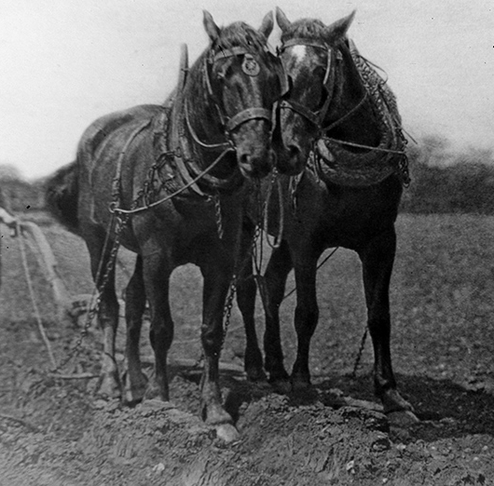
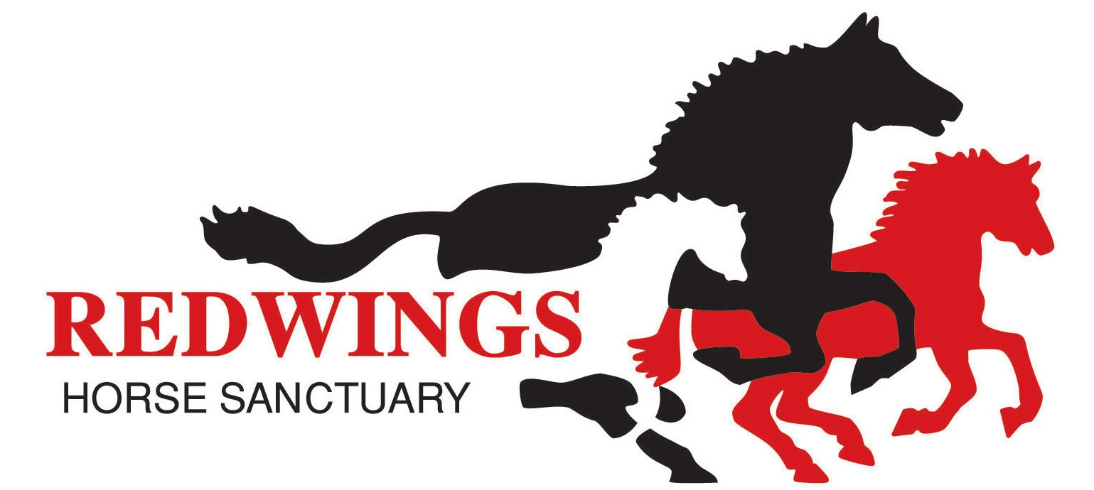
When you’re visiting the horses, see if you can figure out how they’re feeling – once you’ve got an idea from their body language, write a short speech for them that explains to humans why they’re feeling like that.
Starter sentence: When my [Noun] is [Verbs] it means…

