Slide 1
Other Horse Books
Enjoyed Black Beauty? Here are some more horse books to take a look at

Slide 2
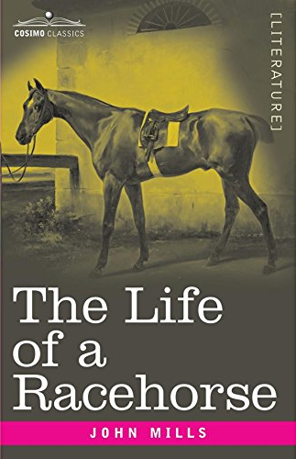
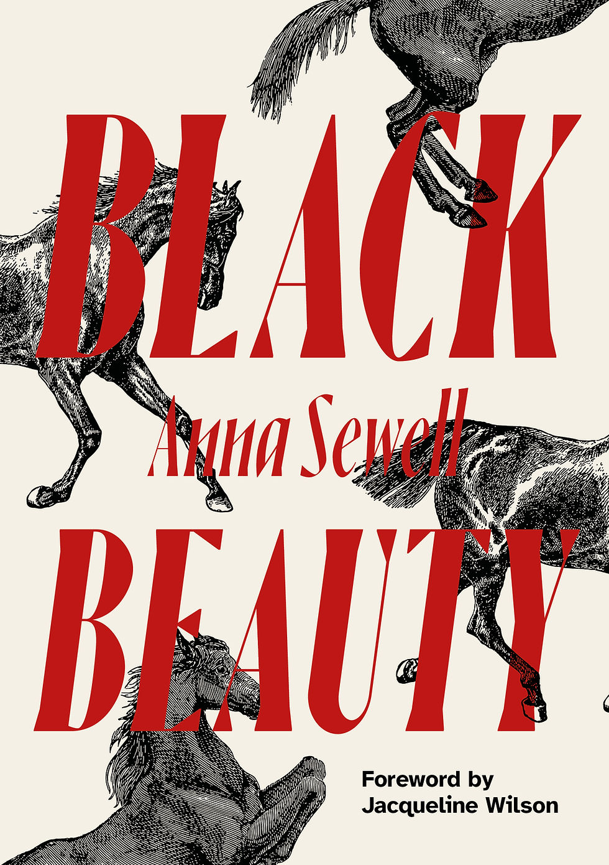
There were some other books about the lives of horses before Black Beauty. The Memoirs of Dick, The Little Poney, Supposed to be Written by Himself; and Published for the Instruction and Amusement of Good Boys and Girls was published in 1800, nearly 80 years before Anna Sewell’s book, and The Life of a Racehorse by John Mills came out in 1854. There were books in the voices of other animals, too, like The Dog of Knowledge; or Memoirs of Bob, The Spotted Terrier. None of them had the impact that Black Beauty had, but we have liked reading books “by” animals for a long time.

Slide 3
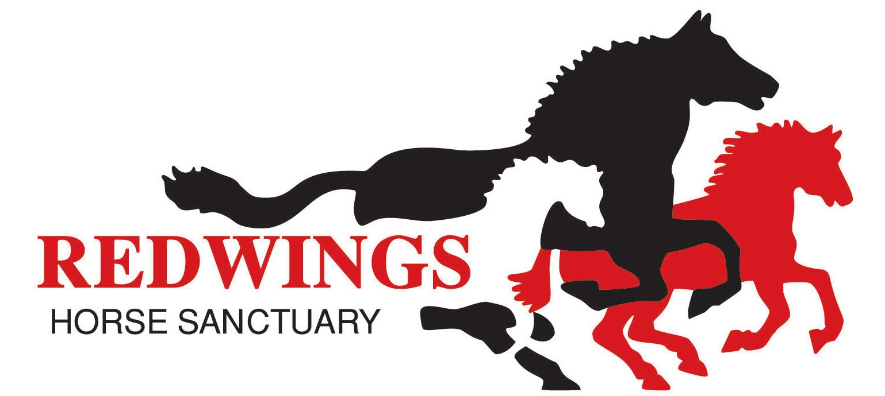
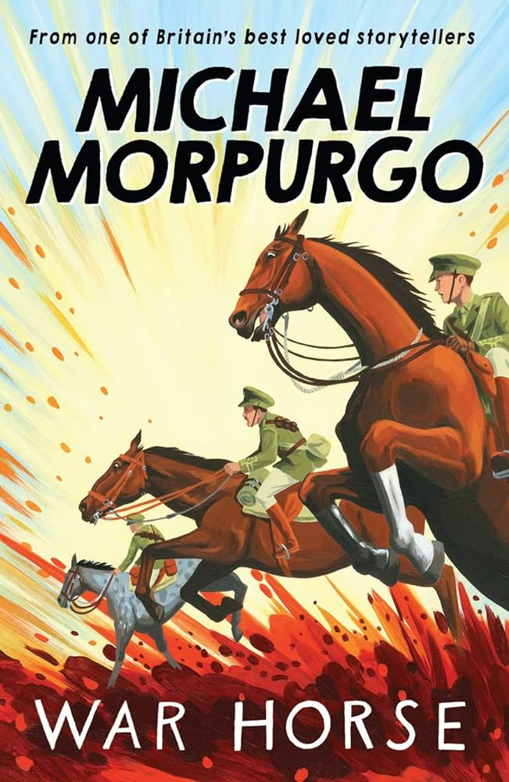
A book that’s probably more familiar to a modern-day audience is War Horse by Michael Morpurgo. Published in 1982, War Horse is told in the voice of Joey, a horse who grows up on a farm and is bought by the British Army for use during the First World War. It had a huge cultural impact – it was adapted into a play and a film, and is still studied in lots of British schools.

Slide 4
Michael Morpurgo took inspiration from Black Beauty when he was writing War Horse, and he was aware of the footsteps he was following in. He says in Such Stuff: A Story-Maker’s Inspiration, “to tell the story, as I now knew I had to tell it, from the perspective of a horse, I was going to have to write it in the first person. The horse would be telling it, writing it. There is, of course, a rather famous book where this happens, […] Black Beauty. So iconic is this classic story that any book using the same technique might seem to be some sort of pale imitation.”

Slide 5
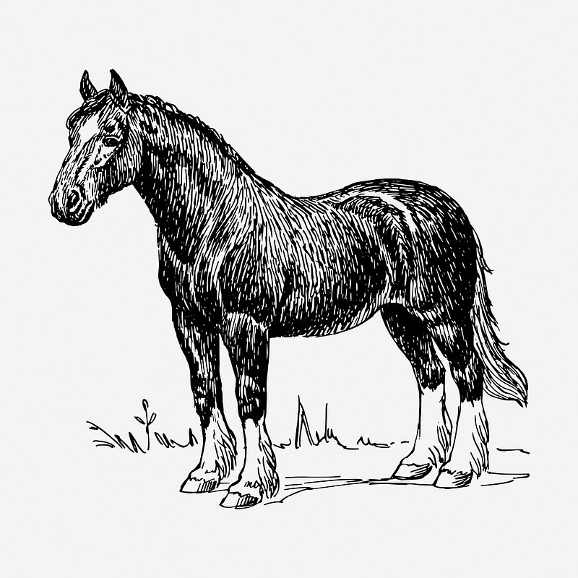
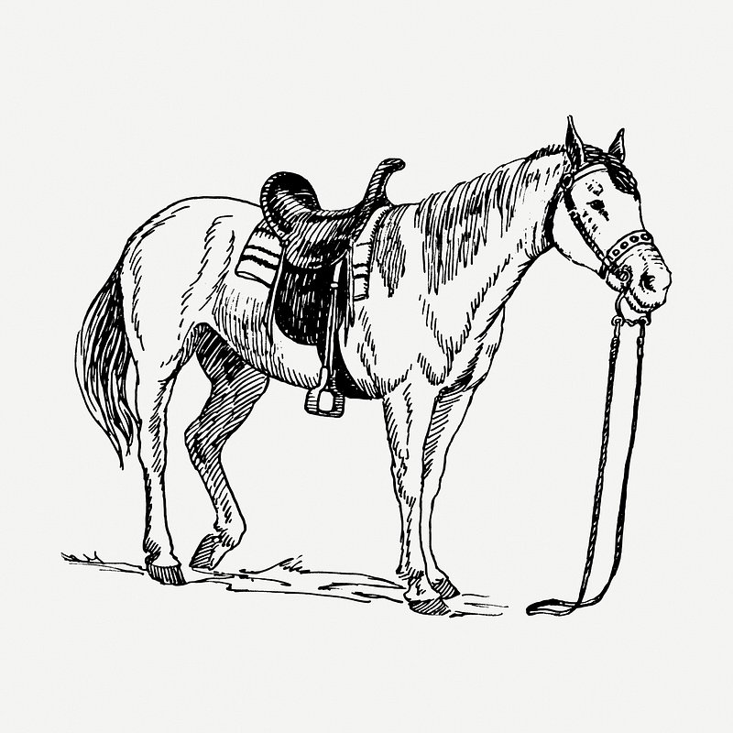
Michael Morpurgo knew that Black Beauty’s success was a lot to live up to! Luckily, he told a story that carries on Anna Sewell’s legacy, not just by using the same technique, but by inspiring a similar emotional reaction: readers love Joey like they love Beauty.

Slide 6
Activity

Slide 7
Create a mood board for your own book about the life of an animal – how can images help convey the tone or mood your story would take? And how might this translate into a book’s cover?

