Slide 1
Horses
Let’s learn more about the history and lives of horses

Slide 2
Horses: History

Slide 3
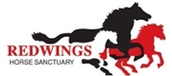
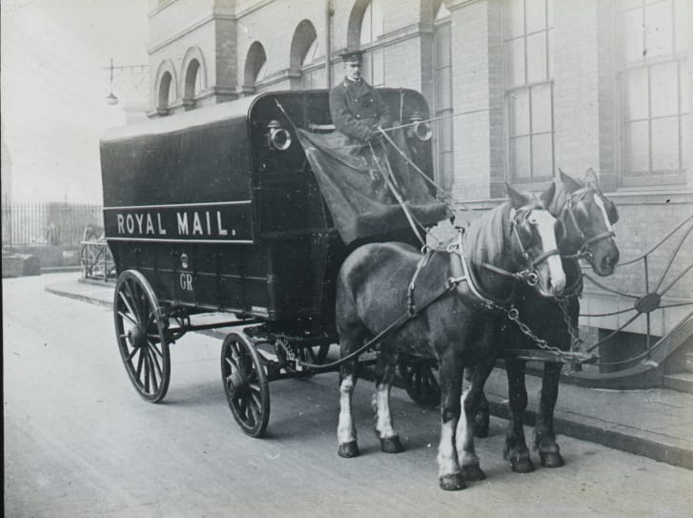
It’s hard for us to understand just how important horses were in everyday life when Anna was writing Black Beauty. They were used for everything from farm work to mining to food production. They would pull canal boats and work in the army and deliver food in towns and cities. They were part of the fire brigade and the postal service. They were also used for transport – whether you were going to visit a friend in a different town or calling for the doctor, horses were involved.

Slide 4
Horses were even an important part of funerals – they were alongside humans throughout their whole lives, and played a role in their final stage. There were so many horses, in fact, that there was one horse to every ten humans.
How many horses would there be in this room/your class/your school?

Slide 5
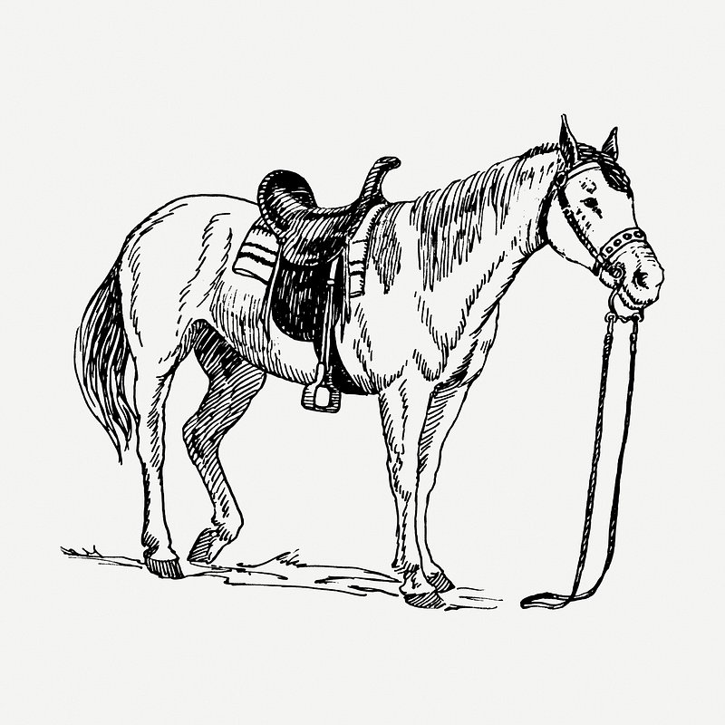
Horses were so important that many jobs came about as a result of their use in everyday life. Even if you didn’t use horses for your work, you might be a saddler, and make equipment for riding horses, or a farrier, who made and fitted horseshoes.

Slide 6
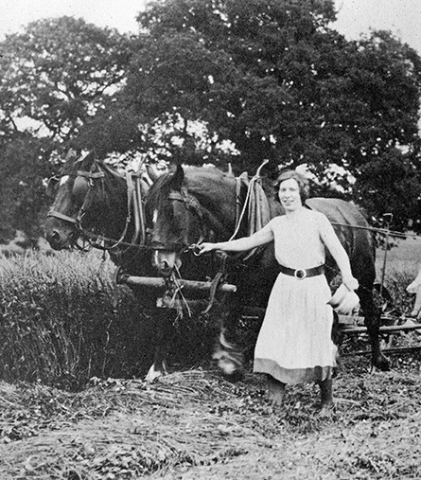
In Norfolk, many horses were used in farming – they would pull the ploughs, pull carts of harvested grains and vegetables, and lend their strength to building and repairs around the farm.

Slide 7
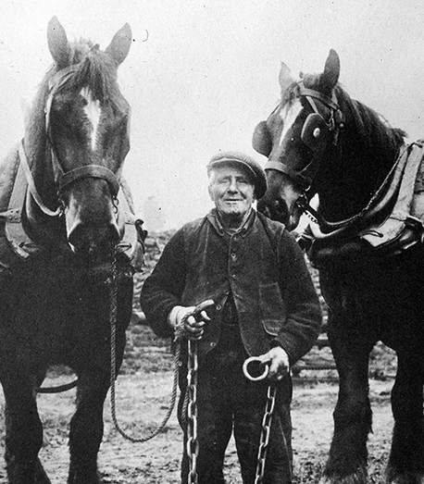
There were even groups of men (and ​some women) who were said to be able to influence horses using magic. They could reassure a nervous horse and help a horse understand what was being asked of them. We now know that these skilled horse handlers were adept at reading and responding calmly to signals horses gave through their face and body, a skill that is still at the heart of good horsemanship today. These folks were known as the ‘Toadmen,’ and they were important people who carefully protected and passed on their secrets.

Slide 8
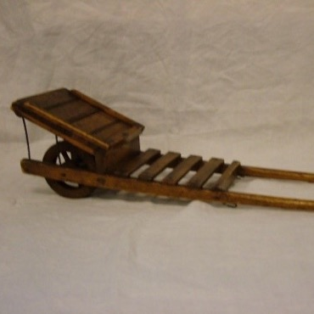
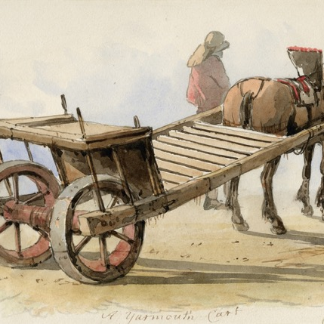
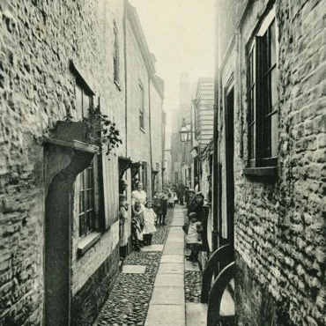
Horses also worked in the towns. In Great Yarmouth, horses would have been used to transport all the goods coming in and out. There was even a special cart invented called a ‘Troll Cart’, which had its wheels tucked under the cart, so it was narrow enough to get down the Yarmouth Rows – the tiny alleys lined with shops and houses. Hardly any rows are left today, but you can still see some off King Street, not far from the Anna Sewell House.
Great Yarmouth
Norwich

Slide 9
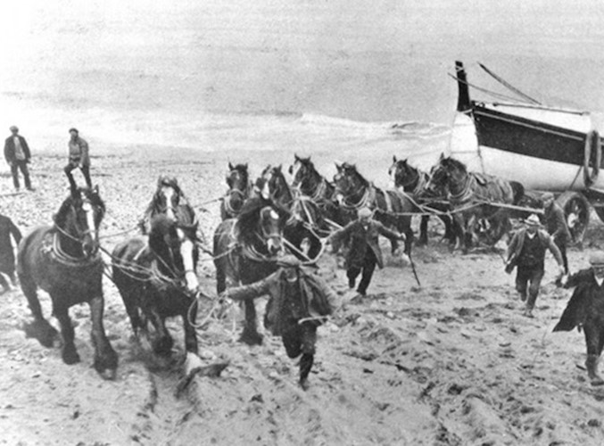
Other jobs for horses in Norfolk included pulling lifeboats into and out of the sea during rescue missions, like in this photo of a lifeboat coming back into Wells harbour.

Slide 10
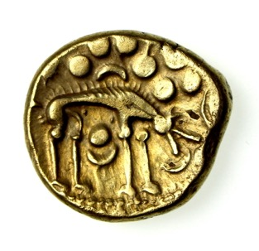
Norfolk’s relationship with horses goes back hundreds of years – there are horses on Iceni coins, which date back to the 1st century, and the Iceni tribe were known as horse breeders, trainers, and traders.

Slide 11
Activity

Slide 12
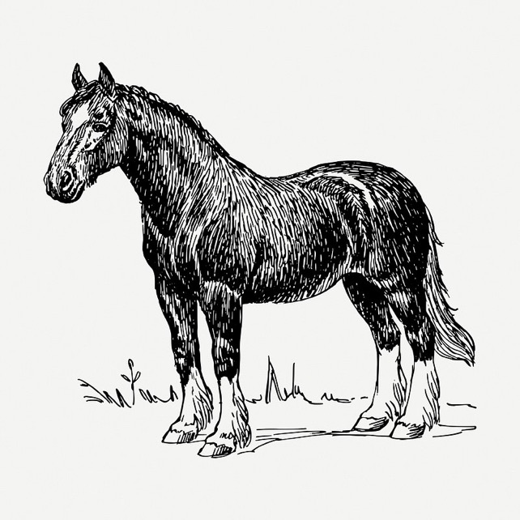
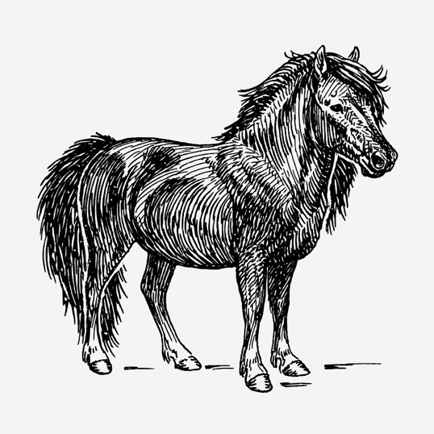
If your best friend was a horse, what would you do together? Would they hold the popcorn when you go to the cinema? Would they help you tidy your room or sit next to you on the bus? Have a go at writing a diary entry about your day with your horse friend.

Slide 13
Horses: Science

Slide 14
Horses have been part of our lives for thousands of years, and have proved fascinating for scientists. They’ve also sparked a lot of stories, and some superstitions. Here are some horse facts:
Horses sleep for around three hours a day. They can doze standing up but have to lie down for the deep sleep they need every day.

Slide 15
Horses have been part of our lives for thousands of years, and have proved fascinating for scientists. They’ve also sparked a lot of stories, and some superstitions. Here are some horse facts:
Horses have bigger eyes than any other land mammal, and have 350-degree vision, with only two small blind spots – one directly behind them, and one directly in front.

Slide 16
Horses have been part of our lives for thousands of years, and have proved fascinating for scientists. They’ve also sparked a lot of stories, and some superstitions. Here are some horse facts:
Horses take an average of about 20-30 seconds to empty their bladders, which is roughly the same duration as humans. In fact, it doesn’t matter how big or small a mammal is, we all take about the same amount of time to have a wee!

Slide 17
Horses have been part of our lives for thousands of years, and have proved fascinating for scientists. They’ve also sparked a lot of stories, and some superstitions. Here are some horse facts:
A horse’s heart weighs around 4.5kg (about 4.5 bags of sugar!) and is roughly the size of a basketball.

Slide 18
Horses have been part of our lives for thousands of years, and have proved fascinating for scientists. They’ve also sparked a lot of stories, and some superstitions. Here are some horse facts:
Horses have been around for 4 million years, and were domesticated by humans around 6000 years ago. Even as far back as 4000 BCE, horses were working with humans and providing companionship.

Slide 19
Activity

Slide 20
Horses sleep for around three hours a day. They can doze standing up but have to lie down for the deep sleep they need every day.
Horses have bigger eyes than any other land mammal, and have 350-degree vision, with only two small blind spots – one directly behind them, and one directly in front.
Horses take an average of about 20-30 seconds to empty their bladders, which is roughly the same duration as humans. In fact, it doesn’t matter how big or small a mammal is, we all take about the same amount of time to have a wee!
A horse’s heart weighs around 4.5kg (that’s about 4.5 bags of sugar!) and is roughly the size of a basketball.
Horses have been around for 4 million years, and were domesticated by humans around 6000 years ago. Even as far back as 4000 BCE, horses were working with humans and providing companionship.
Use one of these facts as inspiration for a short poem, maximum 10 lines. How could you use the fact? Is it the title? Could it act as a metaphor? Could you write a list poem of true and made up facts about horses? Think about the tone we use when we write “factually” and how you can play with that in creative writing.

Slide 21
Horses: Superstition

Slide 22
One of the most common superstitions in the UK is the idea that finding a horseshoe is lucky – which is why you often see them hung on walls and doorways. They are said to protect against witchcraft and evil, and should be hung, according to most sources, in a U shape to hold the luck.

Slide 23
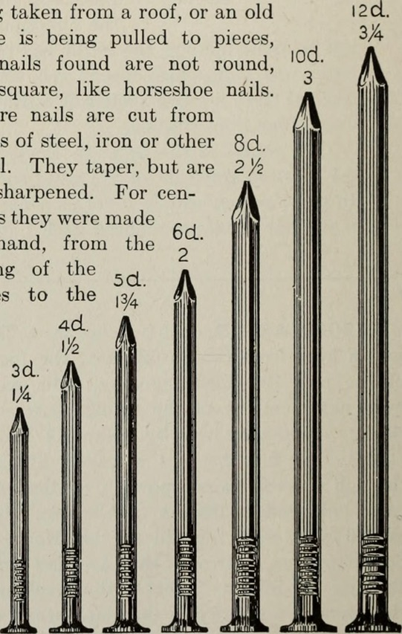
One source from Norfolk takes the superstition even further:
“as a preventative against being bewitched you must carry some nails (the contents of one shoe) from a stallion’s foot in your pocket. These must be constantly carried about, never omitting to take them with you when changing garments”
(from Stephen Roud, The Penguin Guide to the Superstitions of Britain and Ireland, p. 257).

Slide 24
Activity

Slide 25
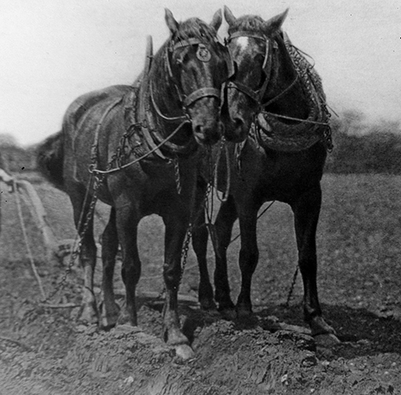
Invent a new horse superstition – would taking a photo of a horse bring good weather? What about braiding a hair from a horse mane into your own hair? Have fun with it!

Slide 26
Horses: Communication

Slide 27
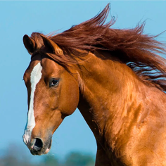
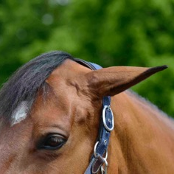
Ears pointed forwards:
This horse is alert – their ears are pointed in the direction of their attention. Horses are very curious, and are always looking out for danger! What might they see?
While the horses we encounter don’t have a voice like Black Beauty does, they can still communicate lots of things to us about how they are feeling. Here is a list of ways horses use body language to let people know what’s going on in their head:
Ears flattened backwards:
This is a sign the horse is unhappy – they are asking their handler to change something about their situation. How could we help make them happier?

Slide 28
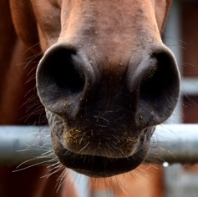
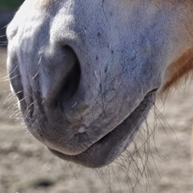
Flared nostrils:
This horse is surprised or frightened. Perhaps something has happened to startle them? They also might just be out of breath from running around.
While the horses we encounter don’t have a voice like Black Beauty does, they can still communicate lots of things to us about how they are feeling. Here is a list of ways horses use body language to let people know what’s going on in their head:
Relaxed bottom lip:
This means the horse is calm and relaxed. What’s making their day so good?

Slide 29
Activity

Slide 30
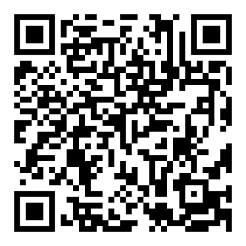
Think about writing in the voice of a horse – what might they want to say? You can go even further by imagining yourself as a horse. Ross Gay does that in his poem ‘Becoming a Horse’, which you can find by scanning the QR code below or clicking here
Set yourself a timer for 15 minutes and have a go at writing something as a horse. You can borrow Ross Gay’s title if you want, or borrow Anna Sewell’s opening for Black Beauty by using the starter ‘I remember…’

